Slide 2
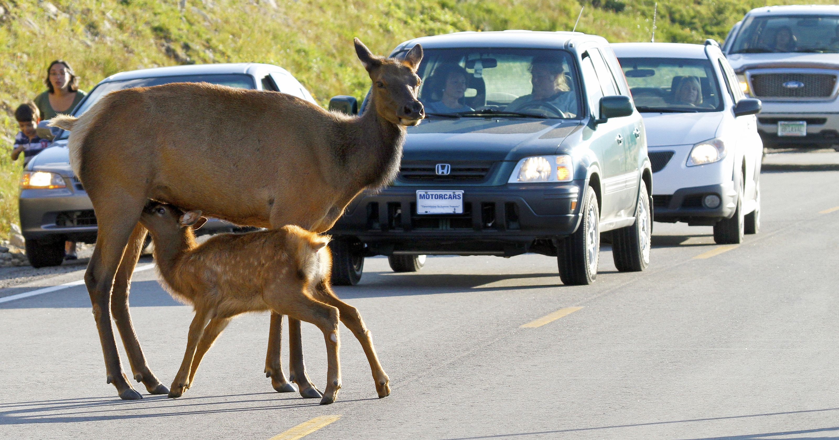

Slide 3
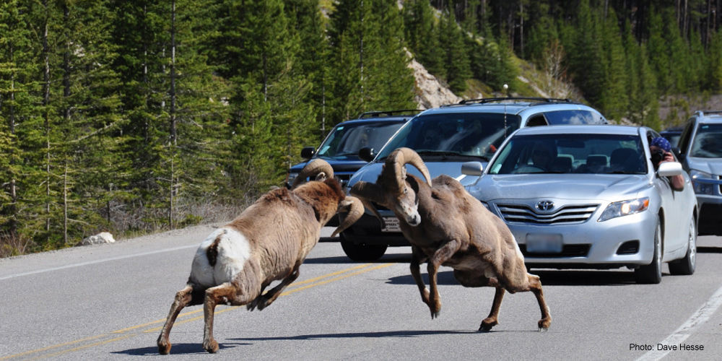

Slide 4
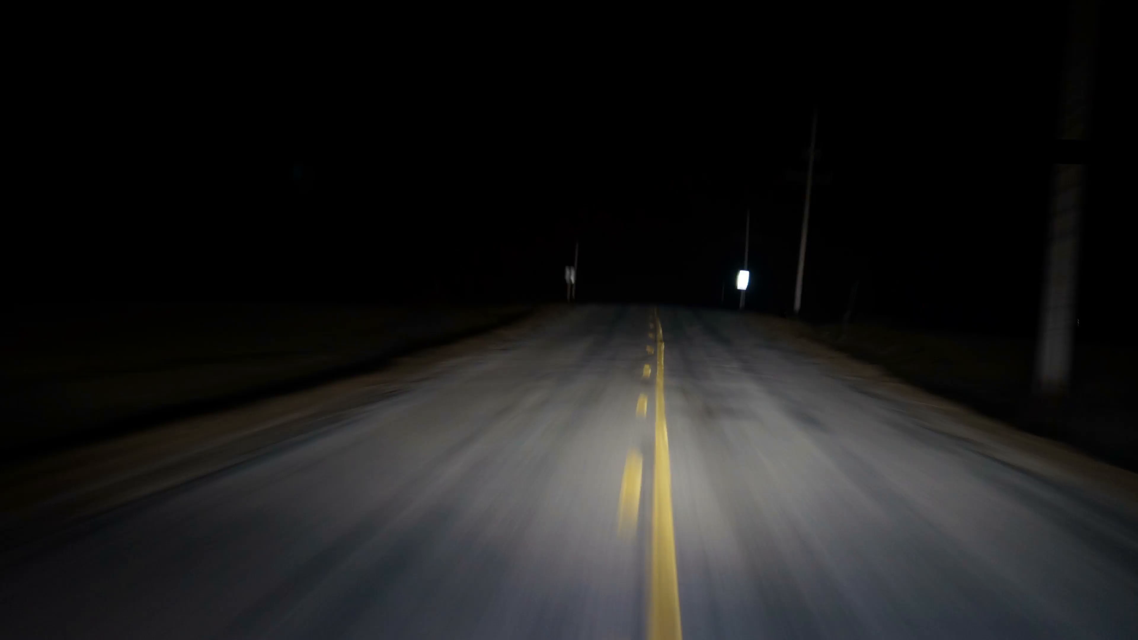

Slide 5
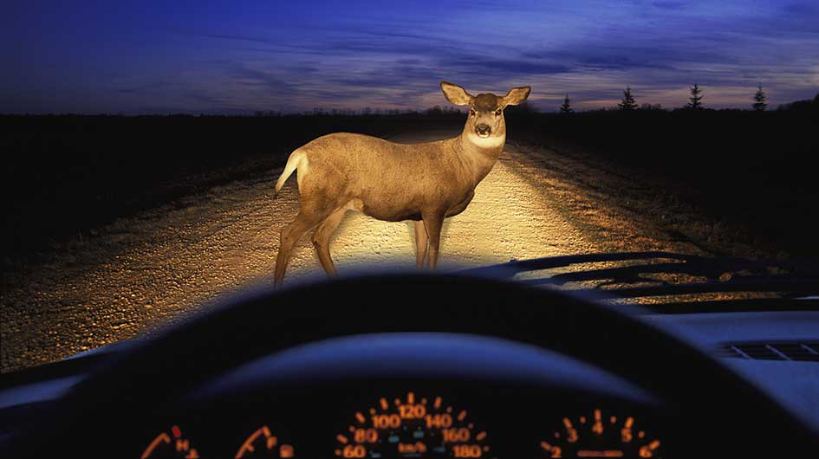

Slide 6
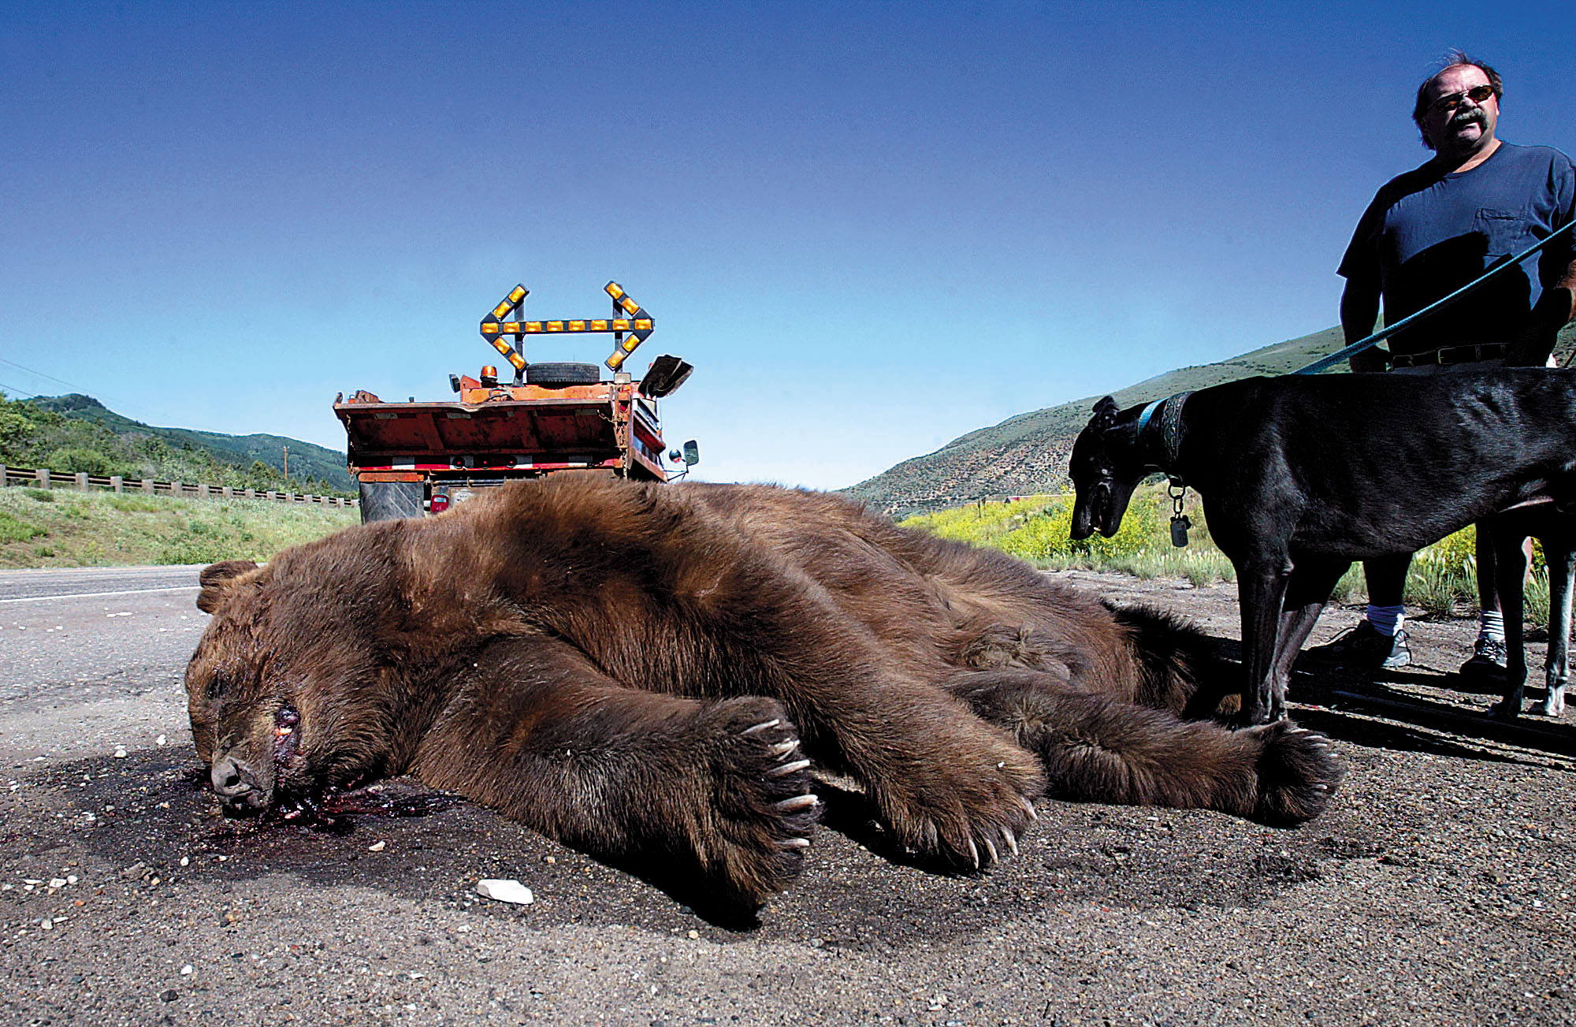

Slide 7
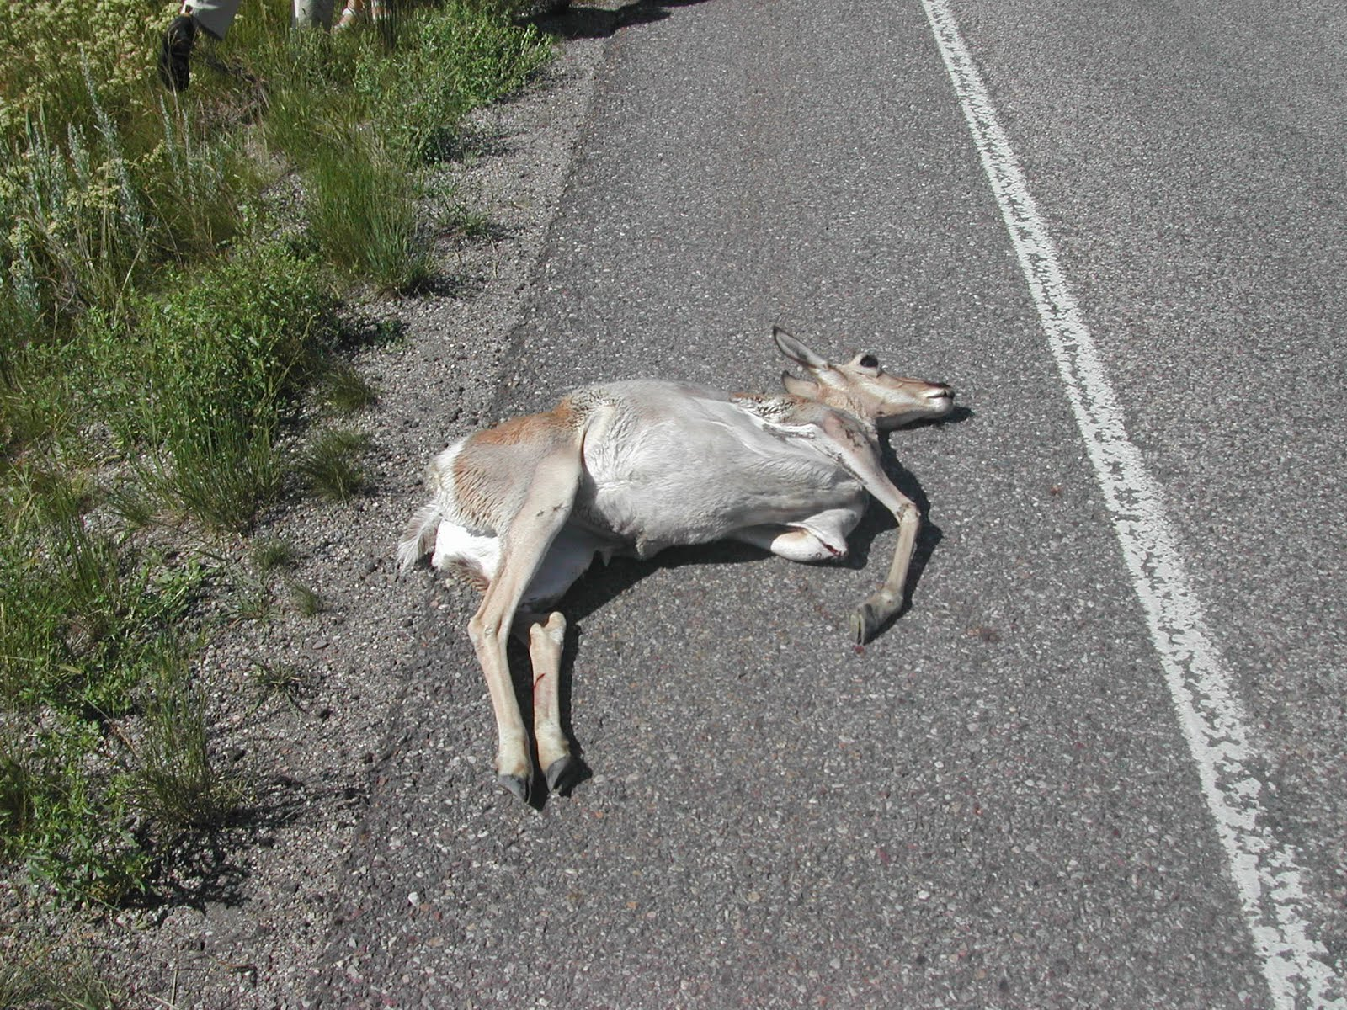
Reduction of the Collisions
between Large Animals & Vehicles

Slide 8
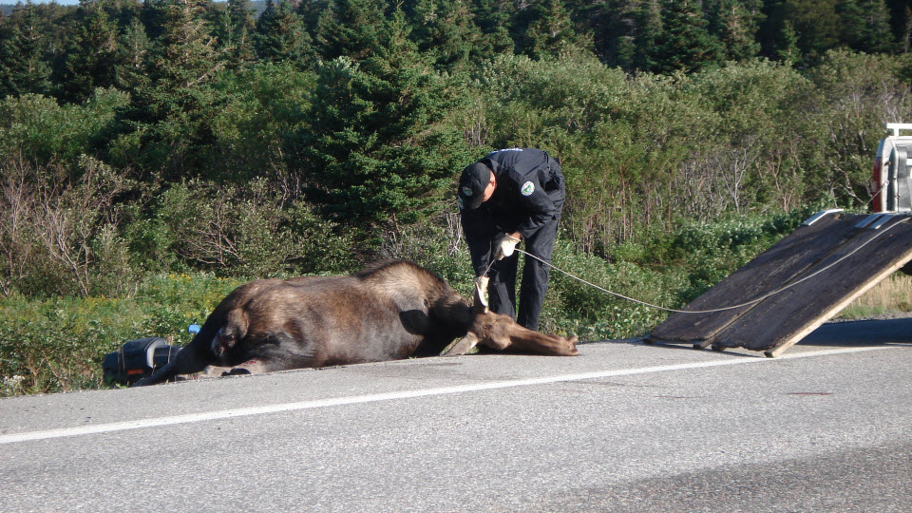
Table of Content
Why should we care?
Solutions
Possible influences
IoT & Future for the Design

Slide 9
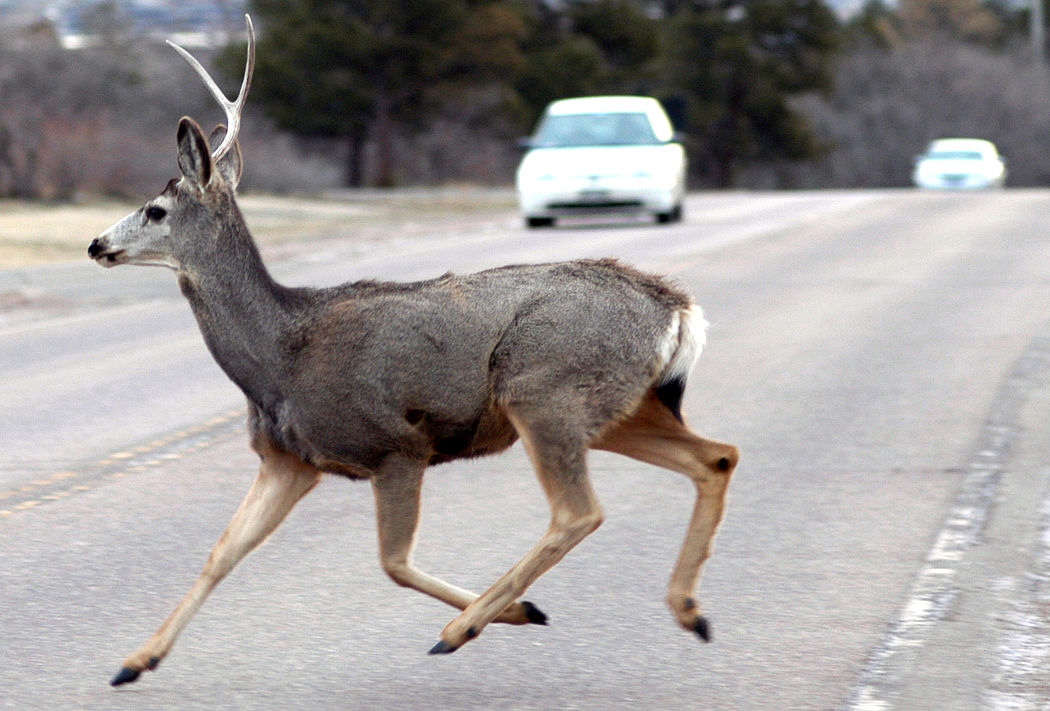
Why should we care?
In Canada from 1999 to 2003:
105 people killed.
9635 collisions resulted in Non-Fatal Injury
161,614 collisions resulted in Property Damage.

Slide 10
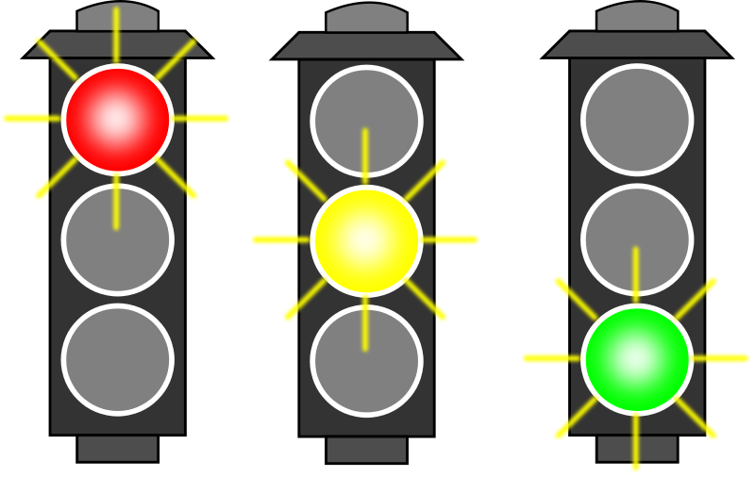
Possible of influences
In terms of reaction to light:
Deers have only two types of cones (photoreactor),
blue and yellow.
Thus, poor at seeing red and orange.
In terms of reaction to sound:
Animals keep distance when see sign of human.

Slide 11

Solutions
Methodology
Prototype
Advantages

Slide 12
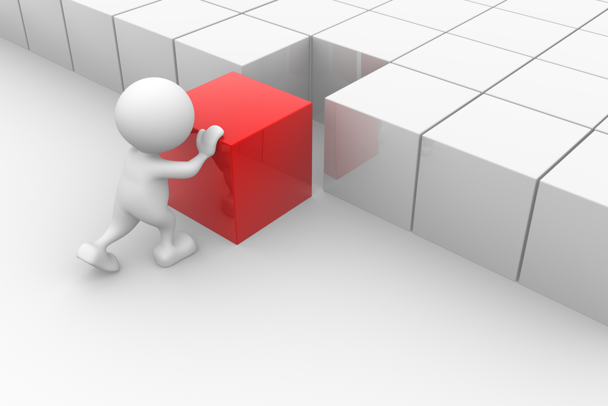
Methodology
General Idea
Alerting the drivers that deers’ presence.
Scaring off deers to keep distance.

Slide 13
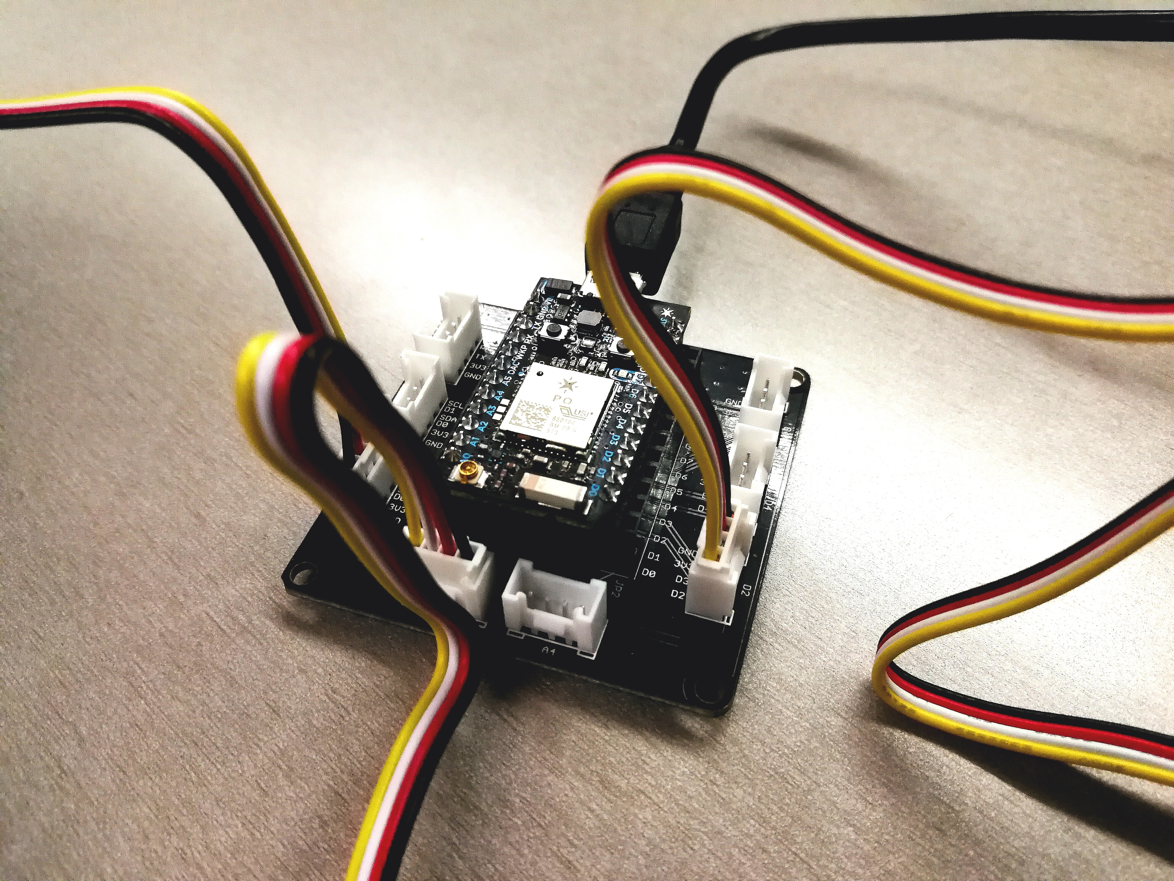
Prototype
Motherboard (Photon Base sheild)
Light sensor
Led (three level of thereat Green Yellow Red)
Buzz
In reality range sensor (ultrasonic) may be implemented.

Slide 14
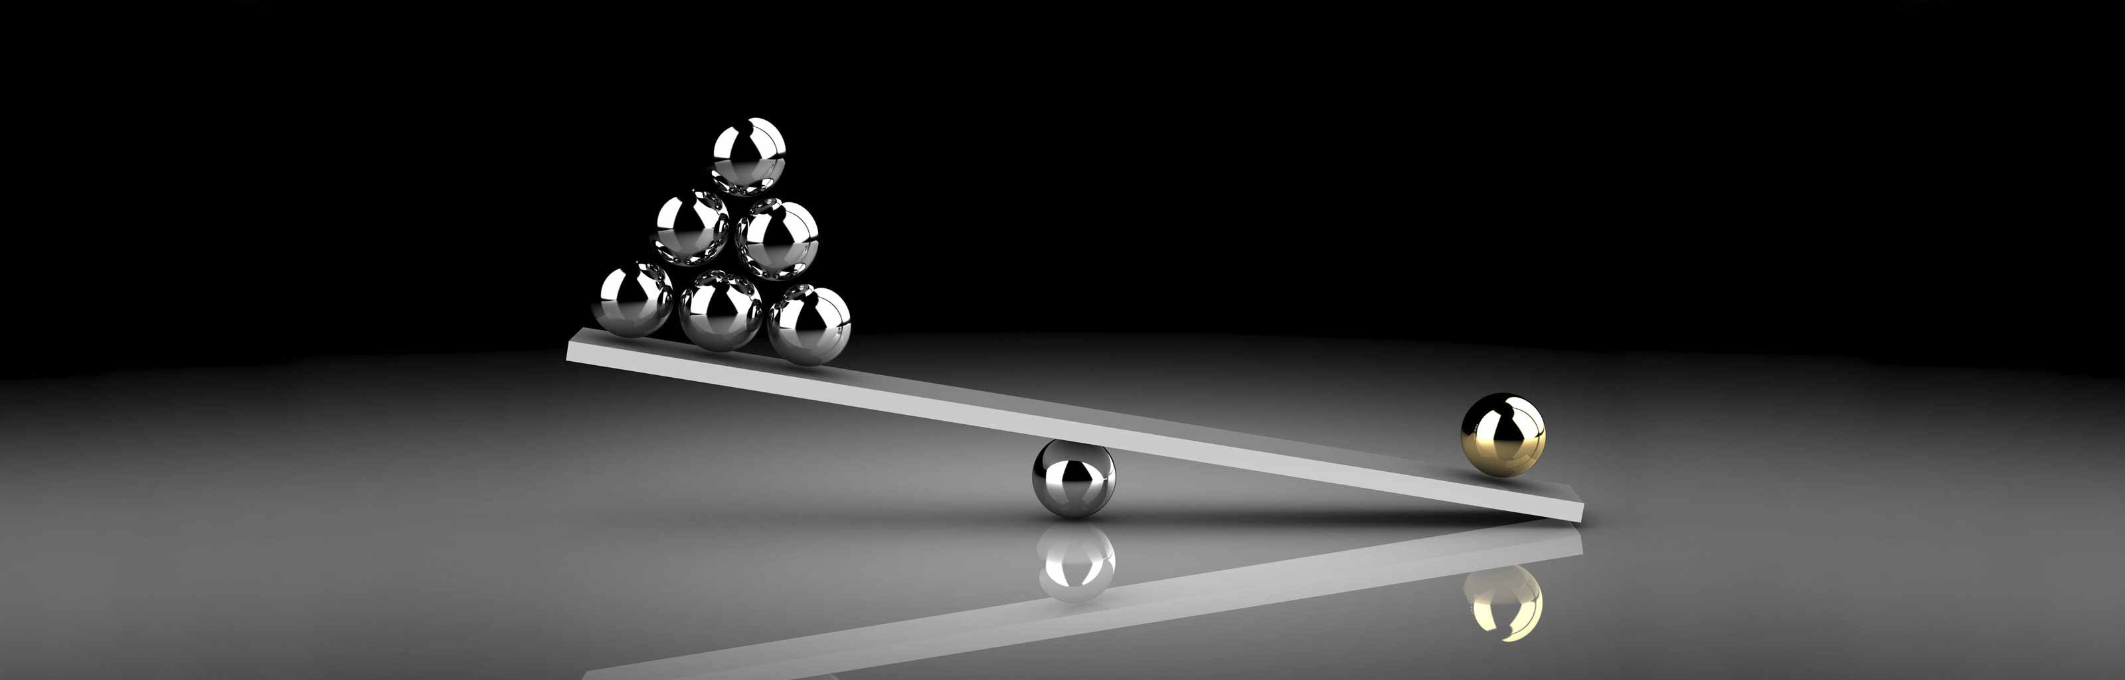
Advantages
Comparing to current system.
Low cost (1 billion financial damage per year in USA).
Construction cost around 20$ for each.
50 million detecting devices can be constructed.
Reduce collisions, death of human, death of wildlife, financial lost, destruction of infrastructure and destruction of ecosystem.

Slide 15

How does it related to IoT
Transfer information of “the presence of deers” to drivers without human-to-human or human-to-computer interactions.
Transfer information of “the approaching car” to deers without human-to-human or human-to-computer interactions.
We build connections and allow communication between drivers and deers without human-to-human or human-to-computer interactions.

Slide 16
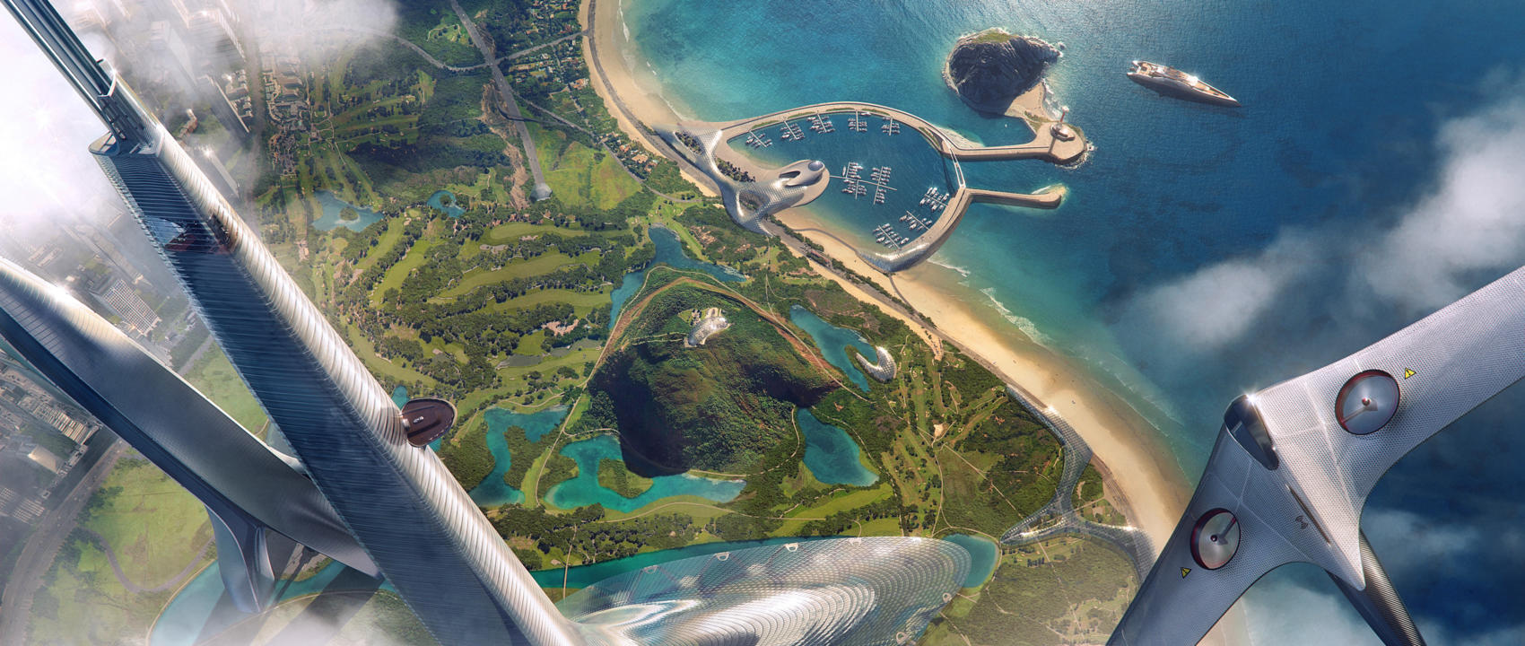
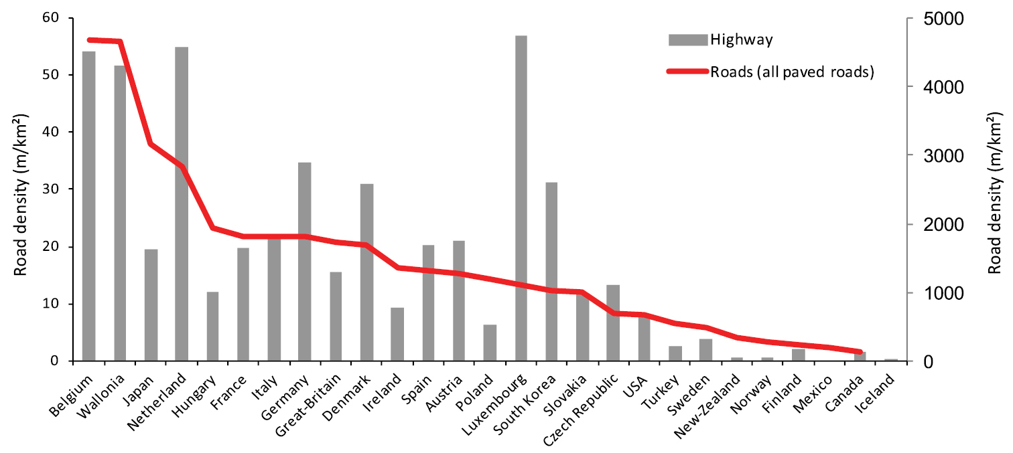
Future at a glance
Many countries have similar problem
Can be implemented worldwide
Design can be utilized easily and effectively
Low cost but do perfect job of reducing death, financial lost, destruction in all ways.

Slide 17
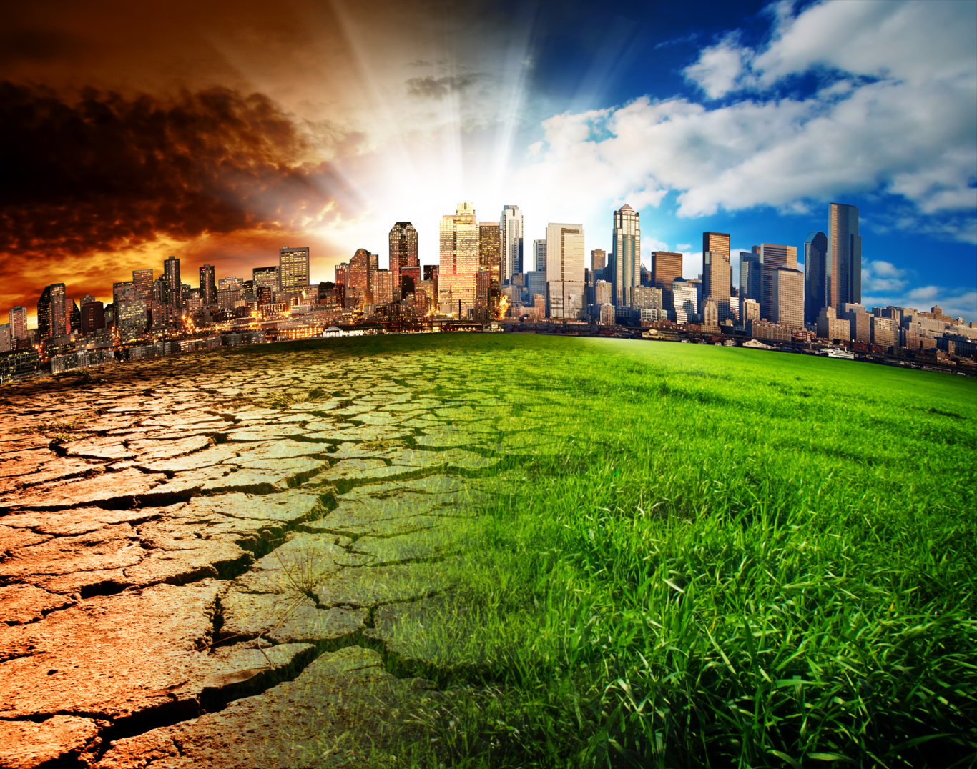
Sustainability: Think beyond, See the big picture
75 species extinct every day
3 species are labelled dead every hour.
Every 2 second, the forest of a size of a football fields are lost.
As human beings develop technology in a fast pace.
We neglect the ecosystem for different extent
It is our duty to take care of our land so the earth can supply our demand longer.
Our design will definitely do a great job and this will be one of the first steps to make the entire earth a better place.

Slide 18
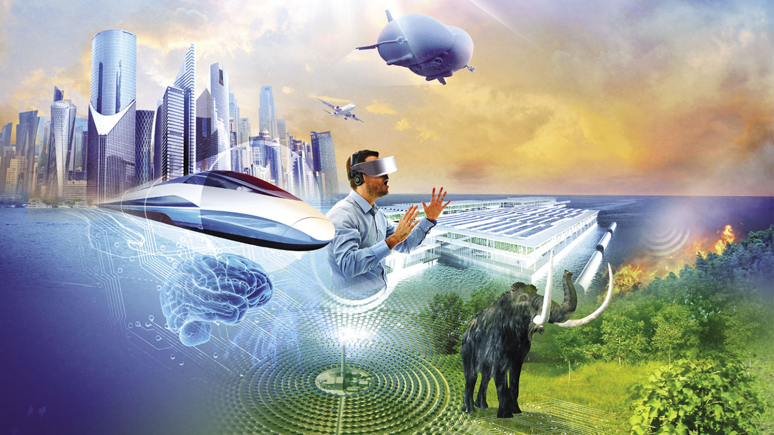
Thank You
Hardware Specialist: Harry
Software Specialist: Yu Sun
Research Provider: Eason Qu
Compacter and Presenter: Shellen Wang
Copyright© 1999-2016 ShellenStudio. All Rights Reserved

